Slide 1



Research Poster
LSTM & Transformer based language models for Odia text classification
Ishan Das 10532854

Slide 2
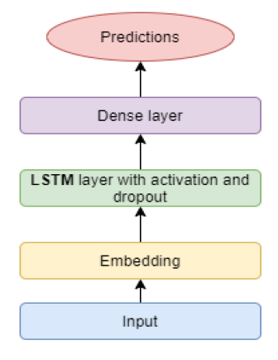
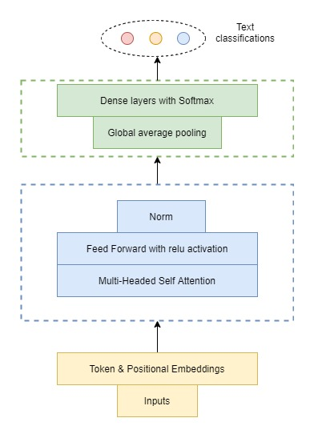
LSTM & TRANSFORMER BASED LANGUAGE MODELS FOR ODIA TEXT CLASSIFICATION
OBJECTIVE
To create language models based on LSTM & Transformer for Odia text classification testing it with embedding of default Keras and FastText.
MODELS
RESULT
A LSTM based architecture in which the LSTM layer is replaced with single, double or bi-directional LSTM
MOTIVATION
Vast outcomes of NLP research including sentiment analysis for product / services from a business standpoint.
Lot of Odia comments / reviews / news available online
Low research on Odia NLP using deep learning.
Statistical test with ANNOVA and Tukey Test
LIMITATIONS & EXTENSTION
Trained on limited data, can be trained on more data & extended with k-fold CV.
Pre-trained FastText vectors, training FT on better corpus.
Pre-training BERT for Odia NLP tasks.
QUESTION
How well does LSTM and Transformer models perform for Odia?
Any Significant difference using FastText embedding?
A custom Transformer architecture with token and positional embeddings
As input to encoder- Multi-head self attention which passes through feed forward layer and normalization.
The decoder is global average pooling with dense layer.
CONCLUSION
F1 score in the range of 80-85 for all the models, and significant difference between LSTM and Transformer based model.
Also to note, models with FastText embeddings had better train/val loss graph but similar or lesser F1.
DATASET
Odia news dataset scrapped from website for 3 categories – State, Sports & Business
20,740
Split into train, test & 5 validation sets

Slide 3
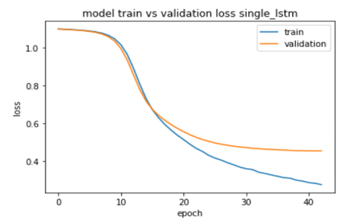
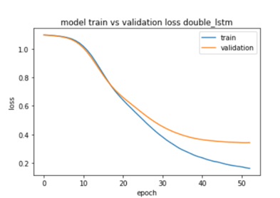
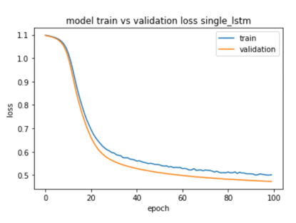
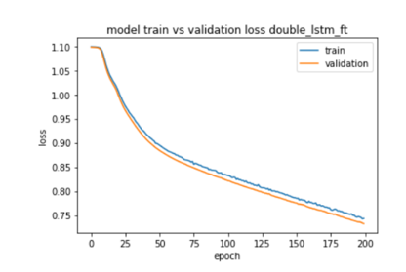
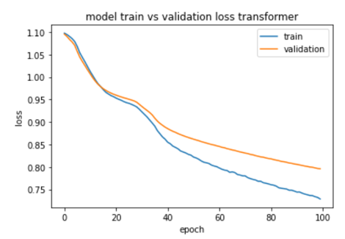
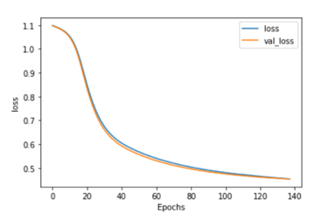
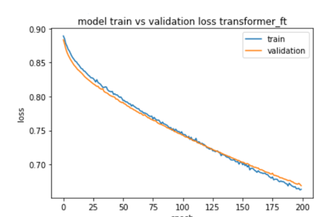
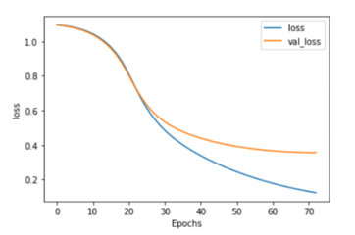
Appendix-A (Graphs)
Keras embedding
FastText embedding
Single LSTM
Double LSTM
Single LSTM
Double LSTM
Model train vs validation loss Bi-Directional
Model train vs validation loss Bi-Directional
Bi-Directional LSTM
Transformer
Bi-Directional LSTM
Transformer

Slide 4

Thank You

